Slide 1

Corona Virus Analysis Using SQL
Internship Project
Batch Name: MIP-DA-07
By: Mahmoud Mohamed Abou Elfadl

Slide 2
OVERVIEW
The COVID-19 pandemic has undeniably left an indelible mark on global public health, necessitating the urgent derivation of data-driven insights to comprehend the virus’s proliferation.
In this project, I embarked on an analytical journey, leveraging SQL and data analysis proficiencies to excavate valuable insights from a comprehensive COVID-19 dataset. This dataset encapsulated a wealth of information, including geographic location, dates, confirmed cases, deaths, and recoveries.
Guided by a meticulously curated set of 16 insightful questions, my analysis aimed to distill meaningful conclusions from the raw data. The objective was to transform the data into knowledge, thereby shedding light on the patterns and trends inherent in the pandemic’s spread.
This endeavor was not merely an exercise in data analysis; it was a mission to contribute to the global understanding of a crisis that has affected us all. By transforming complex data into understandable insights, we can equip decision-makers with the information they need to combat the pandemic effectively.
In conclusion, this project underscored the power of data analysis in navigating through unprecedented times, reinforcing its indispensable role in today’s data-driven world. The insights derived from this analysis serve as a testament to the potential of data to guide us through the complexities of a global pandemic.

Slide 3
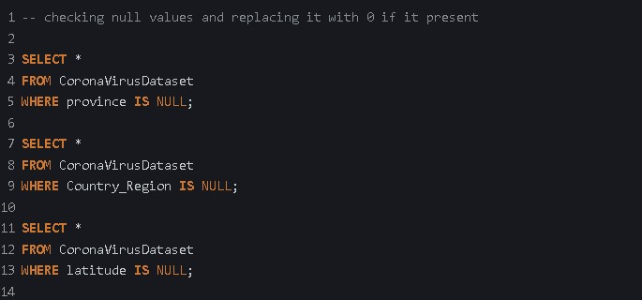

Slide 4
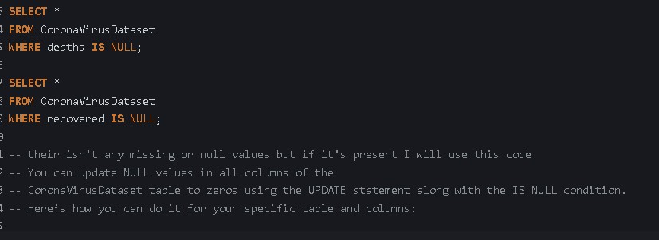

Slide 5
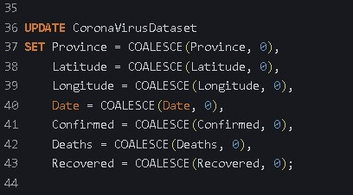

Slide 6
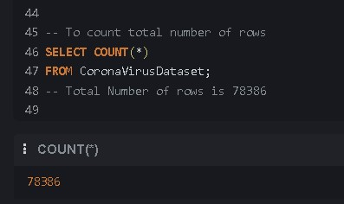

Slide 7
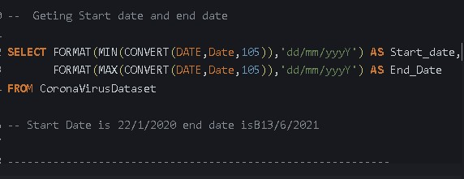

Slide 8
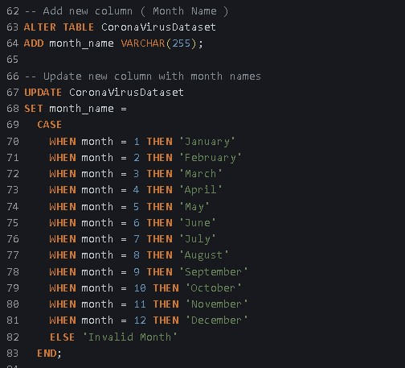

Slide 9
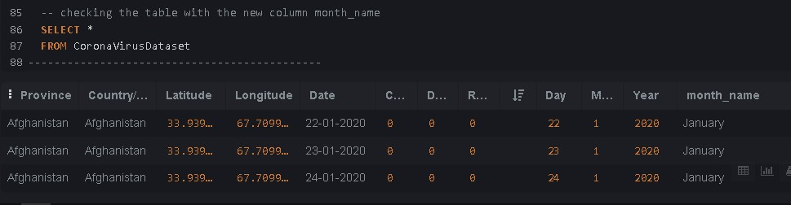

Slide 10
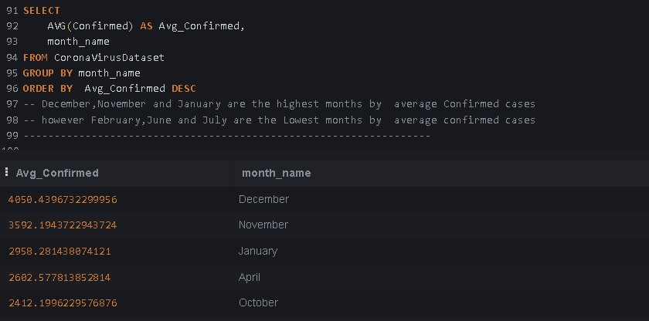

Slide 11
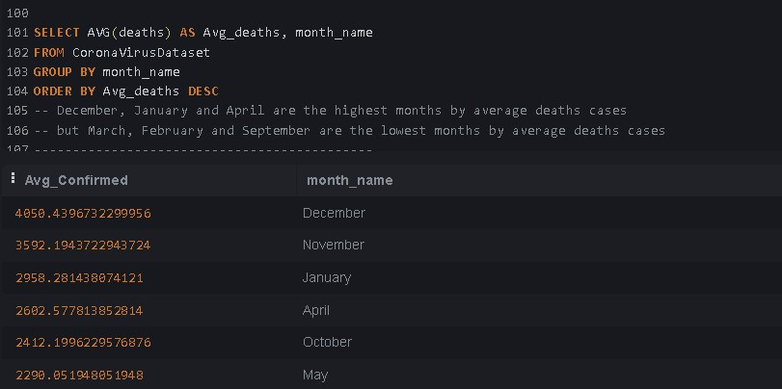

Slide 12
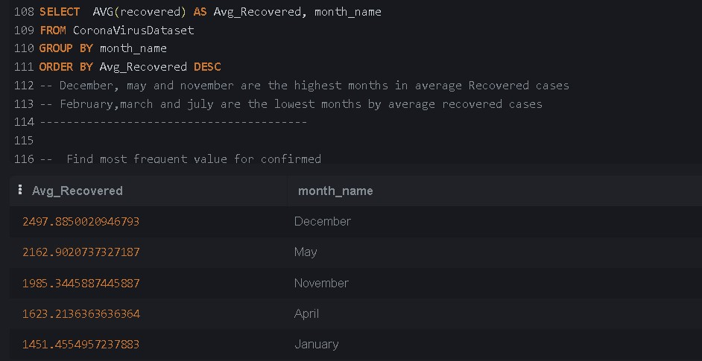

Slide 13
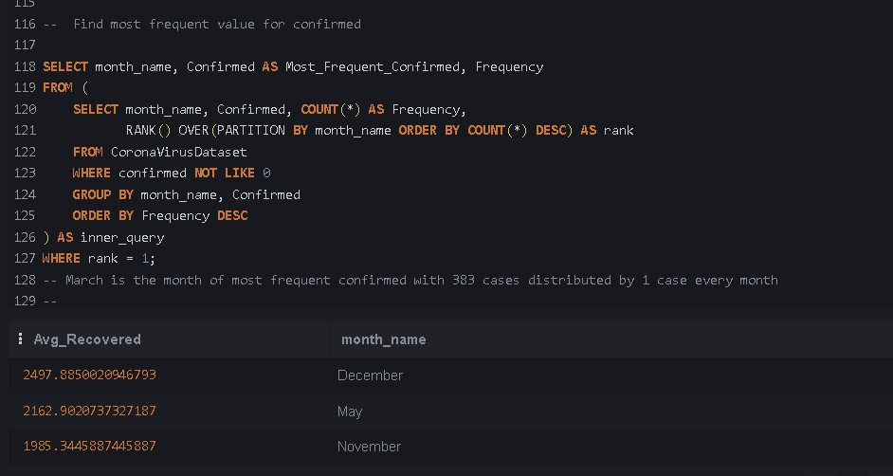

Slide 14
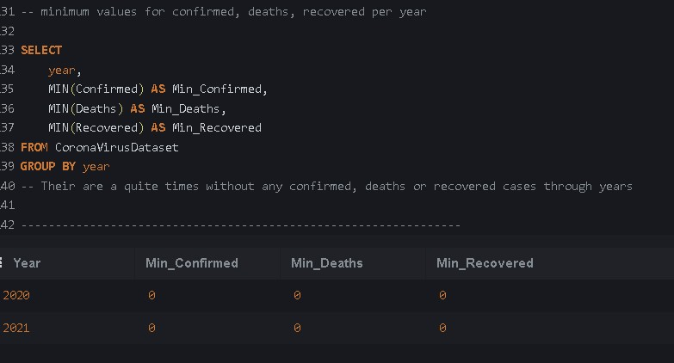

Slide 15
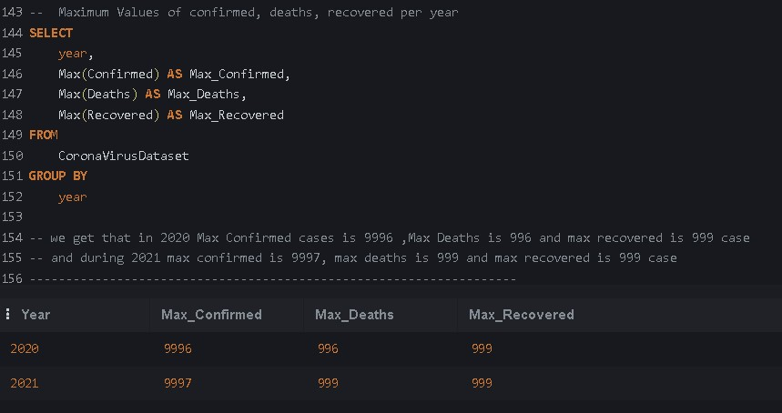

Slide 16
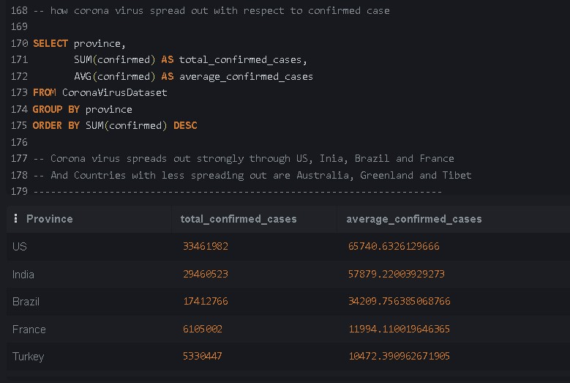

Slide 17
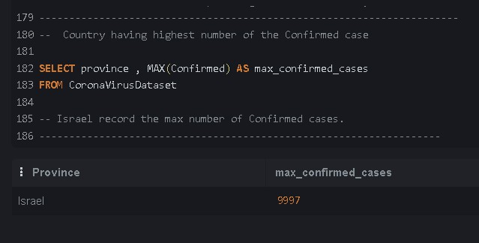

Slide 18
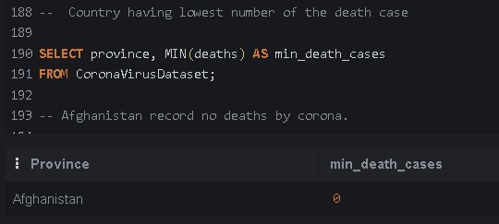

Slide 20
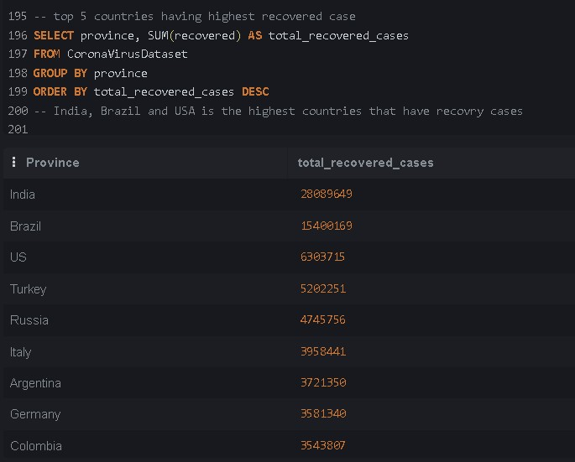

Slide 21
CONCLUSION
The dataset, named Coronavirus Dataset, was thoroughly examined for missing or null values. In the event of their presence, an UPDATE statement along with the IS NULL condition would be used to replace these null values with zeros. However, no such values were found in the dataset.
The dataset consists of a total of 78,386 rows, spanning from 22nd January 2020 to 13th June 2021. A new column, Month Name, was added to facilitate further analysis.
Upon analyzing the average confirmed cases, it was observed that December, November, and January had the highest averages. Conversely, February, June, and July had the lowest averages.
When examining the average death cases, December, January, and April were the months with the highest averages, while March, February, and September had the lowest averages.
In terms of average recovered cases, December, May, and November were the highest, whereas February, March, and July were the lowest.

Slide 22
Interestingly, March was the month with the most frequent confirmed cases, with 383 cases distributed evenly throughout the month.
There were periods without any confirmed, deaths, or recovered cases. The minimum values for confirmed, deaths, recovered per year were observed during these times.
In 2020, the maximum number of confirmed cases was 9,996, deaths was 996, and recovered cases was 999. Similarly, in 2021, the maximum number of confirmed cases was 9,997, deaths was 999, and recovered cases was 999.
The coronavirus spread most strongly through the US, India, Brazil, and France. Countries with less spread include Australia, Greenland, and Tibet.
Israel recorded the maximum number of confirmed cases. Remarkably, Afghanistan recorded no deaths due to the virus. The countries with the highest recovery cases were India, Brazil, USA, Turkey, and Russia.
This concludes the analysis of the Coronavirus Dataset. The findings provide valuable insights into the spread and impact of the virus across different months and countries.

